Slide 1
Clipper & Clamper Circuits

Slide 2
Clippers
Clipping circuit: A wave shaping circuit which controls the shape of the output waveform by removing or clipping a portion of the applied wave.
Half wave rectifier is the simplest example. (It clips negative half cycle).
Also referred as voltage limiters/ amplitude selectors/ slicers.
Applications:
- In radio receivers for communication circuits.
- In radars, digital computers and other electronic systems.
- Generation for different waveforms such as trapezoidal, or square
waves.
- Helps in processing the picture signals in television transmitters.
- In television receivers for separating the synchronising signals from composite picture signals

Slide 3
Types of clippers
According to non- linear devices used:
- Diode clippers and Transistor clippers
According to biasing
- Biased clippers and Unbiased clippers.
According to level of clipping
- Positive clippers, Negative clippers and combination clippers

Slide 4
THUMB RULE
Action of biasing on diode
When diode is forward biased, it acts as a closed switch ( ON state).
When diode is reverse biased, it acts as a open switch ( OFF state).

Slide 5
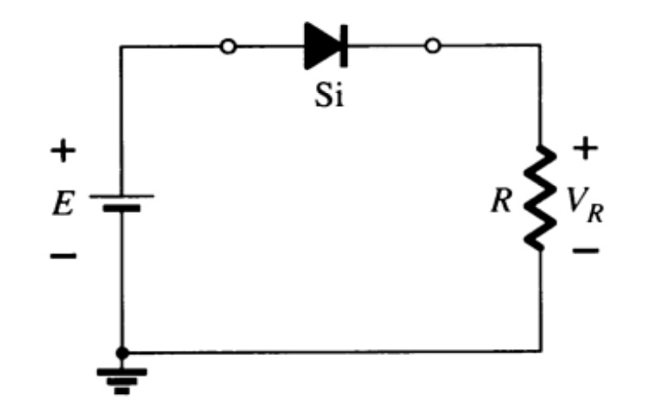
Series Diode Configurations
Reverse Bias
Diodes ideally behave as open circuits
Analysis
V_{D} = E
V_{R} = 0 V
I_{D} = 0 A

Slide 6
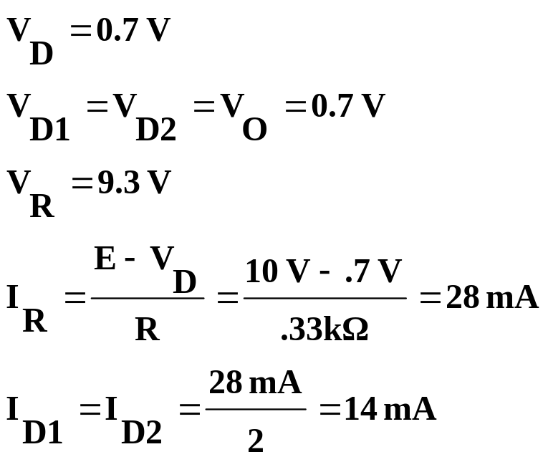
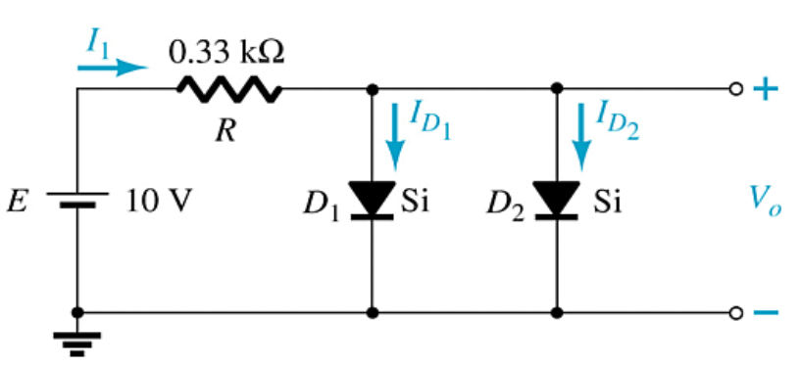
Parallel Configurations

Slide 7
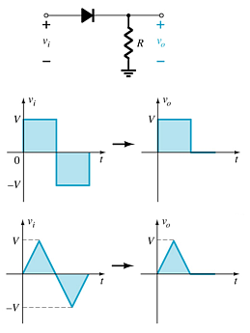
Diode Clippers
The diode in a series clipper “clips” any voltage that does not forward bias it:
A reverse-biasing polarity
A forward-biasing polarity less than 0.7 V (for a silicon diode)

Slide 8
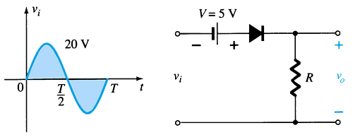
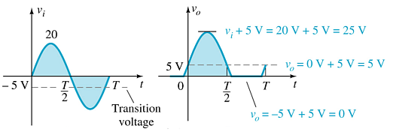
Biased Clippers
Adding a DC source in series with the clipping diode changes the effective forward bias of the diode.

Slide 9
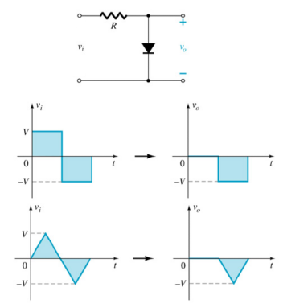
Parallel Clippers
The diode in a parallel clipper circuit “clips” any voltage that forward bias it.
DC biasing can be added in series with the diode to change the clipping level.

Slide 10
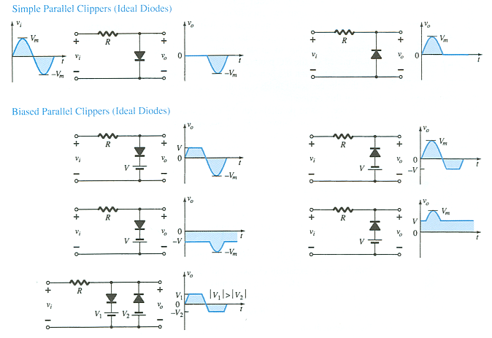
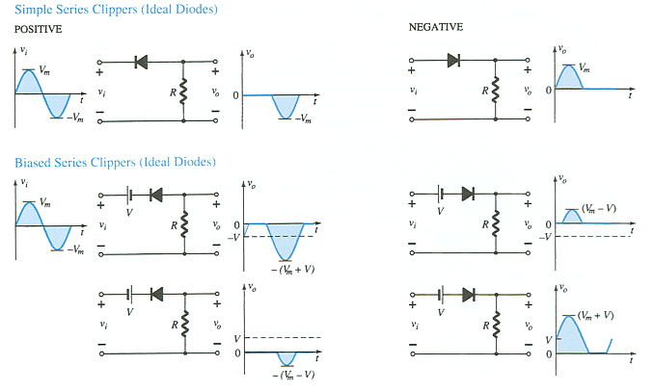
Summary of Clipper Circuits
more…

Slide 11
Summary of Clipper Circuits

Slide 12
Drawbacks
Series Diode Clipper
When diode is “OFF”, there should be no transmission of input signal to output. But in case of high frequency, signal transmission occurs through diode capacitance which is undesirable.
Shunt Diode clippers
When diode is “OFF”, transmission of input signal to output should take place. But in case of high frequency input signals, diode capacitance affects the circuit operation and signal gets attenuated.

Slide 13
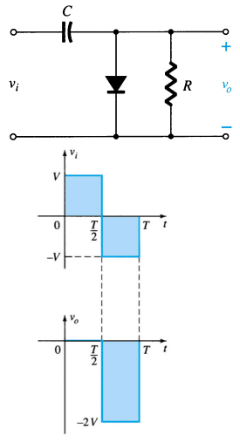
Clampers
A diode and capacitor can be combined to “clamp” an AC signal to a specific DC level.

Slide 14
Note:
Start the analysis of clamping network, by considering that part of the input signal that will forward bias the diode.
During the period that the diode is in the “ON” state, assume that capacitor will charge up instantaneously to a voltage level determined by the network.
Assume that during the perod when the diode is in “OFF” state, capacitor will hold on its established voltage level.
Keep in mind the general rule, that
Total swing of total output = Swing of input signal

Slide 15
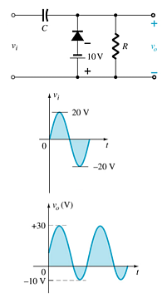
Biased Clamper Circuits
The input signal can be any type of waveform such as sine, square, and triangle waves.
The DC source lets you adjust the DC clamping level.

Slide 16
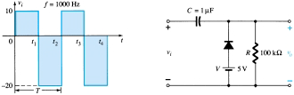

For t1-t2 cycle

Slide 17
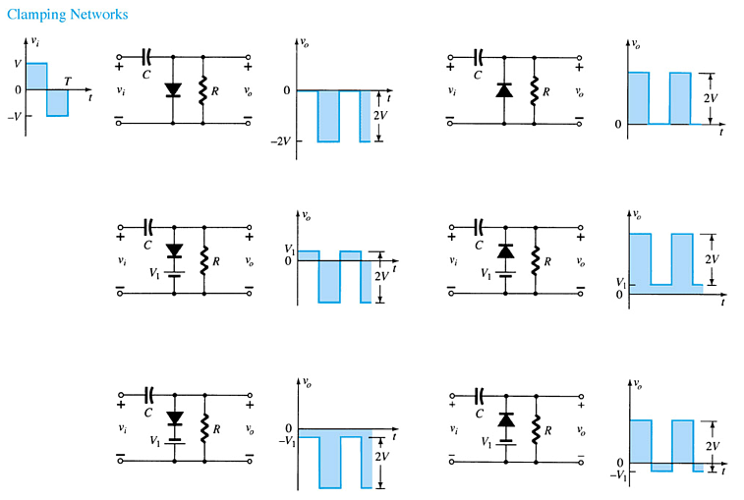
Summary of Clamper Circuits

Slide 18
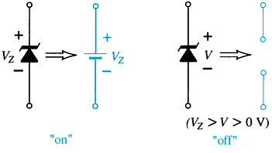
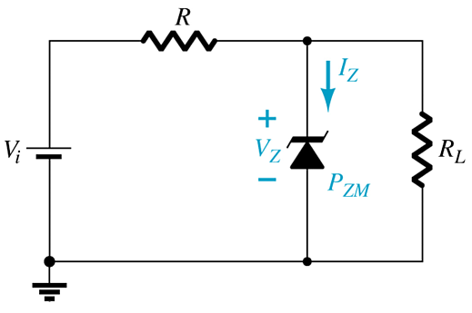
Zener Diodes
The Zener is a diode operated in reverse bias at the Zener Voltage (V_{z}).
When V_{i} ≥ V_{Z}
  The Zener is on
  Voltage across the Zener is V_{Z}
  Zener current: I_{Z} = I_{R} – I_{RL}
  The Zener Power: P_{Z} = V_{Z}I_{Z}
When V_{i} < V_{Z}
  The Zener is off
  The Zener acts as an open circuit

Slide 19

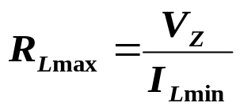
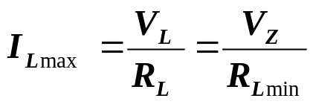
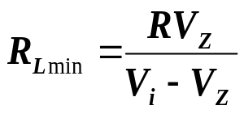
Zener Resistor Values
If R is too large, the Zener diode cannot conduct because the available amount of current is less than the minimum current rating, I_{ZK}. The minimum current is given by:
The maximum value of resistance is:
If R is too small, the Zener current exceeds the maximum current rating, I_{ZM} . The maximum current for the circuit is given by:
The minimum value of resistance is:

Slide 20
Practical Applications
Rectifier Circuits
  Conversions of AC to DC for DC operated circuits
  Battery Charging Circuits
Simple Diode Circuits
  Protective Circuits against
  Overcurrent
  Polarity Reversal
  Currents caused by an inductive kick in a relay circuit
Zener Circuits
  Overvoltage Protection
  Setting Reference Voltages

